Slide 1
18.404/6.840 Lecture 5
Last time: - Context free grammars (CFGs)
- Context free languages (CFLs)
- Pushdown automata (PDA)
- Converting CFGs to PDAs
Today: (Sipser §2.3, §3.1) - Proving languages not Context Free
- Turing machines
- T-recognizable and T-decidable languages
1

Slide 2

Equivalence of CFGs and PDAs
Recall Theorem: $A$ is a CFL iff some PDA recognizes $A$
Done.
Need to know the fact, not the proof
Corollaries:
Every regular language is a CFL.
If $A$ is a CFL and $B$ is regular then $A∩B$ is a CFL.
Proof sketch of (2):
While reading the input, the finite control of the PDA for $A$ simulates the DFA for $B$.
Note 1: If $A$ and $B$ are CFLs then $A∩B$ may not be a CFL (will show today).
Therefore the class of CFLs is not closed under $∩$.
Note 2: The class of CFLs is closed under $∪,∘,∗$ (see Pset 2).
2

Slide 3


















Proving languages not Context Free
Let $B=\left\{0^{k}1^{k}2^{k}\right| k≥0\}$. We will show that $B$ isn’t a CFL.
Pumping Lemma for CFLs: For every CFL $A$, there is a $p$ such that if $s∈A$ and $\left|s\right|≥p$ then $s=uvxyz$ where
1) $uv^{i}xy^{i}z∈A$ for all $i≥0$
2) $vy≠\text{ε}$
3) $\left|vxy\right|≤p$
Informally: All long strings in $A$ are pumpable and stay in $A$.
x can be epsilon; y can be epsilon, but both can’t be epsilon
$$≥p$$
$$u$$
$$v$$
$$x$$
$$y$$
$$z$$
$$s=$$
$∈A$
$∈A$
$$u$$
$$v$$
$$v$$
$$x$$
$$y$$
$$y$$
$$z$$
$$≤p$$
3

Slide 4
T(N) = 2T(N/2) + O(N)
N
N/2
N/2
H = log₂N
N/4
N/4
N/4
N/4
1
1
1

Slide 5









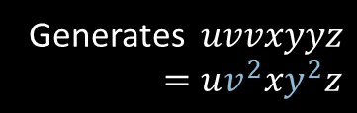












Pumping Lemma – Proof
Pumping Lemma for CFLs: For every CFL $A$, there is a $p$ such that if $s∈A$ and $\left|s\right|≥p$ then $s=uvxyz$ where
1) $uv^{i}xy^{i}z∈A$ for all $i≥0$
2) $vy≠\text{ε}$
3) $\left|vxy\right|≤p$
E
Proof by picture:
E
R
E
R
The grammar itself has only fixed numbers in it (repetition R)
$$u$$
$$v$$
$$y$$
$$z$$
R
R
R
$$x$$
$$v$$
$$x$$
$$y$$
Generates $uvvxyyz$
$=uv^{2}xy^{2}z$
$$u$$
$$z$$
R
Generates $uxz$
$=uv^{0}xy^{0}z$
$$s=$$
$$u$$
$$v$$
$$x$$
$$y$$
$$z$$
Long $s→$ tall parse tree
“cutting and pasting” argument
4

Slide 6

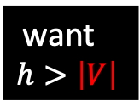
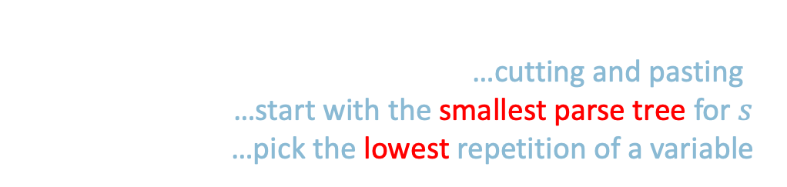






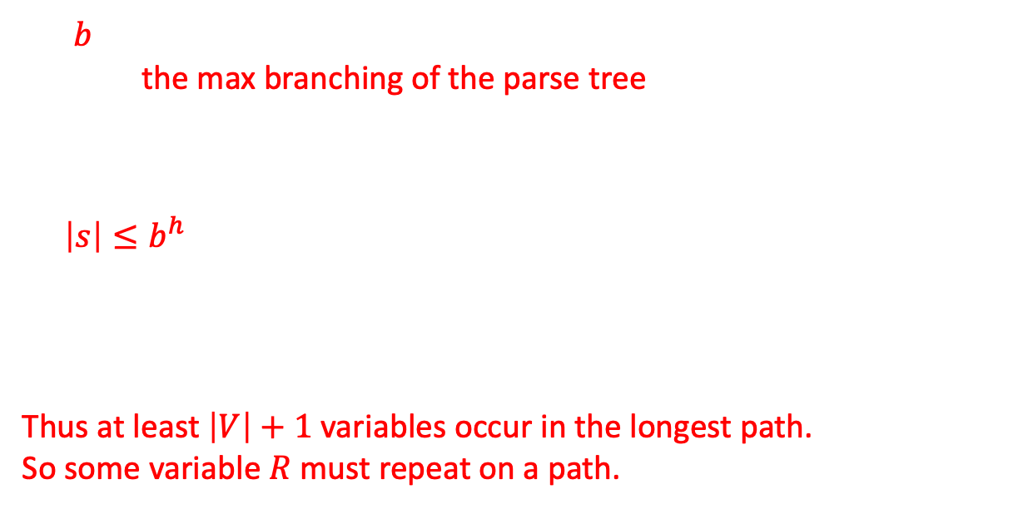

Pumping Lemma – Proof details
Read the book to get a better understanding
For $s∈A$ where $\left|s\right|≥p$, we have $s=uvxyz$ where:
1) $uv^{i}xy^{i}z∈A$ for all $i≥0$ …cutting and pasting
2) $vy≠\text{ε}$ …start with the smallest parse tree for $s$
3) $\left|vxy\right|≤p$ …pick the lowest repetition of a variable
Cannot be an inefficient parse tree which can be shorted and still generate s
Do not have R -> R
The |vxy| won’t be very long
Because that would force another repetition to occur
Let $b=$ the length of the longest right hand side of a rule (E $→$ E+T)
$=$ the max branching of the parse tree
Let $h=$the height of the parse tree for $s$.
A tree of height $h$ and max branching $b$ has at most $b^{h}$ leaves.
So $\left|s\right|≤b^{h}$.
Let $p=b^{\left|V\right|}+1$ where $\left|V\right|=$ # variables in the grammar.
So if $\left|s\right|≥p>b^{\left|V\right|}$ then $\left|s\right|>b^{|V|}$ and so $h>\left|V\right|$.
Thus at least $\left|V\right|+1$ variables occur in the longest path.
So some variable $R$ must repeat on a path.
E
E+T
We want height bigger than the number of variables |V|
Which can force a repetition of R
E
want $$h>\left|V\right|$$
R
R
$$s=$$
$$u$$
$$v$$
$$x$$
$$y$$
$$z$$
use $\left|s\right|>b^{\left|V\right|}$
5
set $p=b^{\left|V\right|}+1$

Slide 7









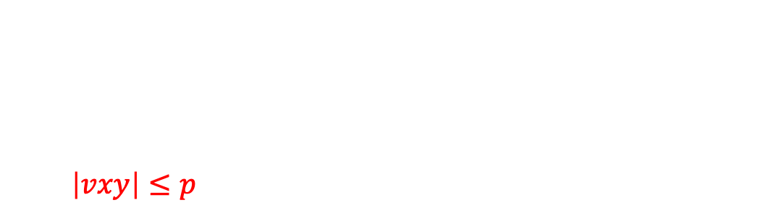
Example 1 of Proving Non-CF
Pumping Lemma for CFLs: For every CFL $A$, there is a $p$ such that if $s∈A$ and $\left|s\right|≥p$ then $s=uvxyz$ where
1) $uv^{i}xy^{i}z∈A$ for all $i≥0$
2) $vy≠\text{ε}$
3) $\left|vxy\right|≤p$
Key: how to divide ?
Cannot be the hole string (a piece of it)
From Book:
Condition2 says that either v or y is nonempty:
If both v and y contain only one type of alphabet symbol, let’s say both a and b or both b and c. in this case, the string uv²xy²z cannot contain equal number of a’s b’s and c’s
If either v or y contains more than one type of symbol, then the uv²xy²z may contain equal numbers of the three alphabets symbol but not in the correct order
Let $B=\left\{0^{k}1^{k}2^{k}\right| k≥0\}$
Show: $B$ is not a CFL
Proof by Contradiction:
Assume (to get a contradiction) that $B$ is a CFL .
The CFL pumping lemma gives $p$ as above. Let $s=0^{p}1^{p}2^{p}∈B$.
Pumping lemma says that can divide $s=uvxyz$ satisfying the 3 conditions.
Condition 3 ($\left|vxy\right|≤p$) implies that $vxy$cannot contain both 0s and 2s.
So $uv^{2}xy^{2}z$ has unequal numbers of 0s, 1s, and 2s.
Thus $uv^{2}xy^{2}z∉B$, violating Condition 1. Contradiction! Therefore our assumption ($B$ is a CFL) is false. We conclude that $B$ is not a CFL .
$$s=$$
$$00⋯0011⋯1122⋯22$$
$$u$$
$$v$$
$$x$$
$$y$$
$$z$$
$$≤p$$
6
Check-in 5.1

Slide 8
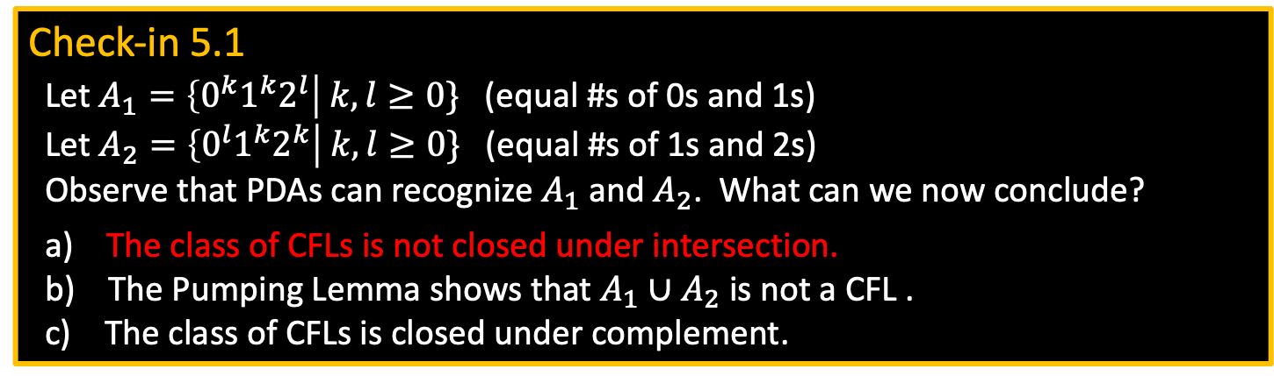
Check-in 5.1
Let $A_{1}=\left\{0^{k}1^{k}2^{l}\right| k,l≥0\}$ (equal #s of 0s and 1s)
Let $A_{2}=\left\{0^{l}1^{k}2^{k}\right| k,l≥0\}$ (equal #s of 1s and 2s)
Observe that PDAs can recognize $A_{1}$ and $A_{2}$. What can we now conclude?
a) The class of CFLs is not closed under intersection.
b) The Pumping Lemma shows that $A_{1}∪A_{2}$ is not a CFL .
c) The class of CFLs is closed under complement.
The intersection is just B = {0^{k}1^{k}2^{k)}
Context-free language is closed under union

Slide 9










Example 2 of Proving Non-CF
Pumping Lemma for CFLs: For every CFL $A$, there is a $p$ such that if $s∈A$ and $\left|s\right|≥p$ then $s=uvxyz$ where
1) $uv^{i}xy^{i}z∈A$ for all $i≥0$
2) $vy≠\text{ε}$
3) $\left|vxy\right|≤p$
Not a very clear description (many cases)
F is the two copies of same string
Let $F=\left\{ww\right| w∈Σ^{∗}\} .$ $Σ=\{0,1\}$.
Show: $F$ is not a CFL.
Assume (for contradiction) that $F$ is a CFL.
The CFL pumping lemma gives $p$ as above. Need to choose $s∈F$. Which $s$?
Try $s_{1}=0^{p}10^{p}1∈F$. But $s_{1}$ can be pumped and stay inside $F$. Bad choice of $s$.
Try $s_{2}=0^{p}{1^{p}0}^{p}1^{p}∈F$. Show $s_{2}$ cannot be pumped $s_{2}=uvxyz$ satisfying the 3 conditions.
Condition 3 implies that $vxy$ does not overlap two runs of 0s or two runs of 1s.
Therefore, in $uv^{2}xy^{2}z$, two runs of 0s or two runs of 1s have unequal length.
So $uv^{2}xy^{2}z∉F$ violating Condition 1. Contradiction! Thus $F$ is not a CFL.
$$s_{1}=$$
$$000⋯001000⋯001$$
$$u$$
$$v$$
$$x$$
$$y$$
$$z$$
$$s_{2}=$$
$$0⋯01⋯10⋯01⋯1$$
$$u$$
$$v$$
$$x$$
$$y$$
$$z$$
7

Slide 10
Turing Machines (TMs)
Model of general-purpose computer
head
a
b
a
b
b
˽
˽
. . .
Finite control
read/write input tape
Head can read and write
Head is two way (can move left or right)
Tape is infinite (to the right)
Infinitely many blanks “˽“ follow input
Can accept or reject any time (not only at end of input)
8

Slide 11

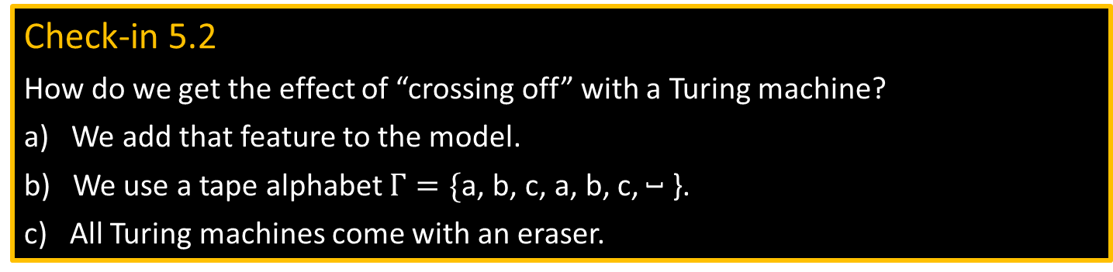
TM – example
TM recognizing $B=\left\{{\text{a}}^{k}{\text{b}}^{k}{\text{c}}^{k} | k≥0\right\}$
Scan right until ˽ while checking if input is in ${\text{a}}^{∗}{\text{b}}^{∗}{\text{c}}^{∗}$, reject if not.
Return head to left end.
Scan right, crossing off single a, b, and c.
If the last one of each symbol, accept.
If the last one of some symbol but not others, reject.
If all symbols remain, return to left end and repeat from (3).
head
input tape
Finite control
a
a
a
b
b
b
c
c
c
˽
˽
accept
Check-in 5.2
How do we get the effect of “crossing off” with a Turing machine?
a) We add that feature to the model.
b) We use a tape alphabet $Γ=\{\text{a}$, $\text{b}$, $\text{c}$, $\text{a}$, $\text{b}$, $\text{c}$, ˽ }.
c) All Turing machines come with an eraser.
9
Check-in 5.2

Slide 12
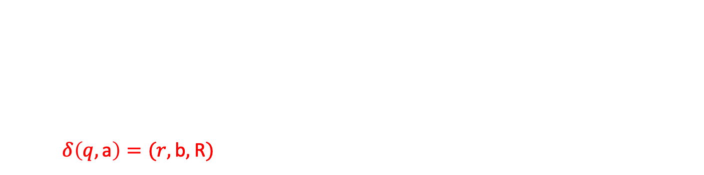
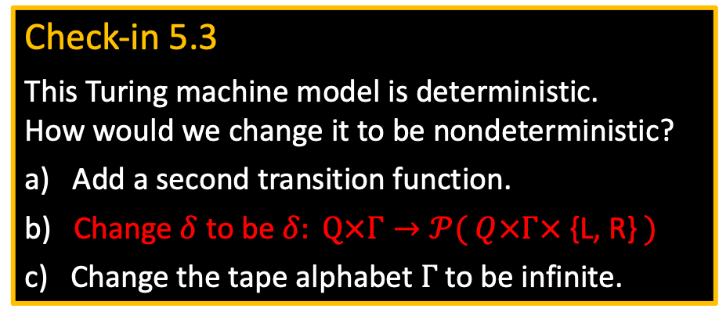

TM – Formal Definition
Defn: A Turing Machine (TM) is a 7-tuple $(Q, Σ, Γ, δ,q_{0}, q\text{acc} , q\text{rej})$
$Σ$ input alphabet
$Γ$ tape alphabet ($Σ⊆Γ$)
$δ: Q×Γ→Q×Γ×$ {L, R} (L = Left, R = Right)
$δ\left(q,\text{a}\right)=(r,\text{b},$ R$)$
Example: if we are in state q and the head is looking at an a currently on the tape, then we can move to state r. then change a to b and we move the head right 1.
On input $w$ a TM $M$ may halt (enter $q\text{acc}$ or $q\text{rej}$) or $M$ may run forever (“loop”).
So $M$ has 3 possible outcomes for each input $w$:
Accept $w$ (enter $q\text{acc}$)
Reject $w$by halting (enter $q\text{rej}$ )
Reject $w$by looping (running forever)
Check-in 5.3
This Turing machine model is deterministic. How would we change it to be nondeterministic?
a) Add a second transition function.
b) Change $δ$ to be $δ: Q×Γ→𝒫( Q×Γ×$ {L, R} $)$
c) Change the tape alphabet $Γ$ to be infinite.
10
Check-in 5.3

Slide 13
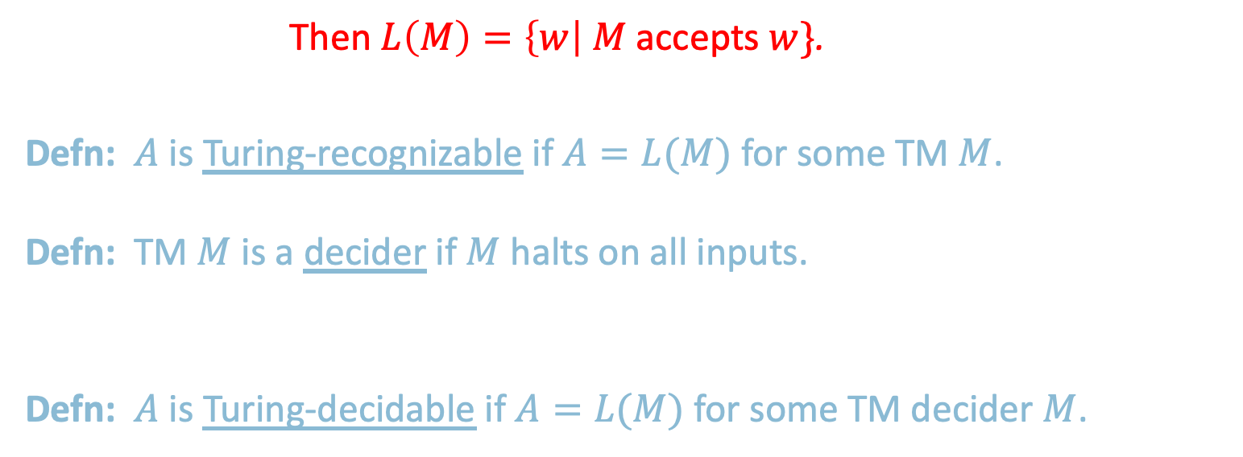
TM Recognizers and Deciders
The language of the machine is the collection of strings that the machine accepts
Let $M$ be a TM. Then $L\left(M\right)=\left\{w\right| M$ accepts $w\}$.
Say that $M$ recognizes $A$ if $A=L(M)$.
Defn: $A$ is Turing-recognizable if $A=L(M)$ for some TM $M$.
Defn: TM $M$ is a decider if $M$ halts on all inputs.
Say that $M$ decides $A$ if $A=L(M)$ and $M$ is a decider.
Defn: $A$ is Turing-decidable if $A=L(M)$ for some TM decider $M$.
If a Turing machine may sometimes reject by looping, then it’s only recognizing its language
T-recognizable
Machine halts -> made a decision of accepting or rejecting at that point which it had halted
T-decidable
If the Turing machine is always halting, which means always rejecting by explicitly coming to a reject state and halting, then we says it deciding the language
CFLs
regular
11

Slide 14
Quick review of today
Proved the CFL Pumping Lemma as a tool for showing that languages are not context free.
Defined Turing machines (TMs).
Defined TM deciders (halt on all inputs).
T-recognizable and T-decidable languages.
12

Slide 15
Semantic Gap
HLL
Small Semantic Gap
ISA (CISC)
Translation
Engine
Large Semantic Gap
Compiler
Implemented ISA
ISA (RISC)
Processor
Control Signals

Slide 16
MIT OpenCourseWare
https://ocw.mit.edu
18.404J Theory of Computation
Fall 2020
For information about citing these materials or our Terms of Use, visit: https://ocw.mit.edu/terms.

